Slide 1
Research for MUN Conferences

Slide 2
Country Research
Delegates are assigned a country to represent
Critical that delegates are aware about the stance of their country
Delegates must adhere to foreign policy of their country, even if delegate does not agree
Allows delegates to look into possible allies country may have
Notes:
Not always the case. Delegates in more advanced committees may represent a person or part of a government

Slide 3
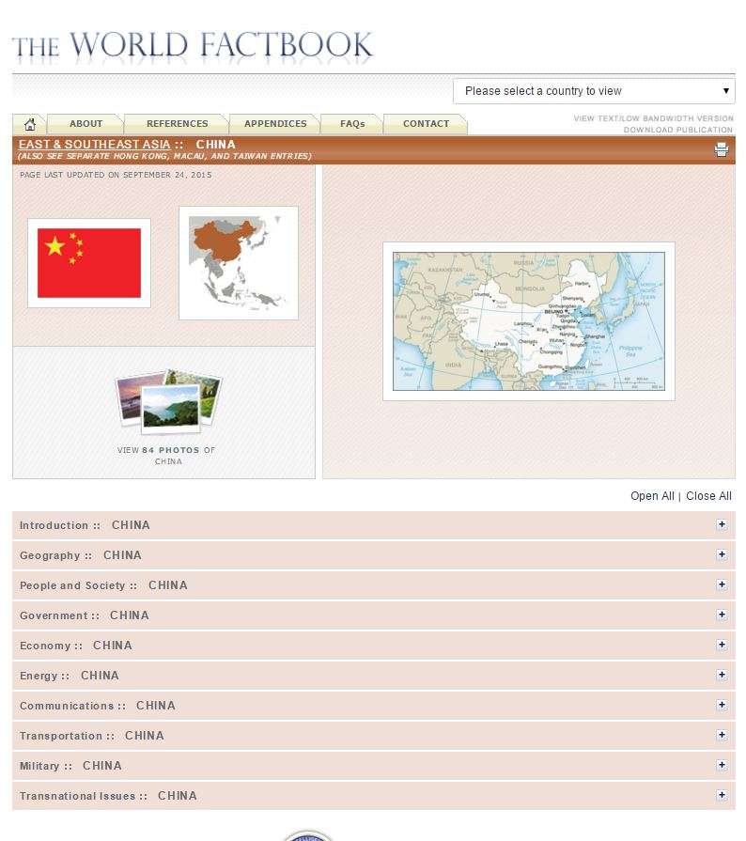
What country research should include
Essential Background info
Location
Neighbors
Country size
Type of government and economy
Trade partners
Current Events involving your country
Stances on all topics committee is covering
Formal treaties and international agreements your country has signed
Country’s foreign relationships (esp. to major world powers)
The CIA World Factbook is an excellent source of information

Slide 4
Committee Research
Know what your committee is and what it can do:
Committee mandate
Membership
Organization
Powers and limitations
The charter of the United nations gives the UNSC broad powers to respond to crises worldwide

Slide 5
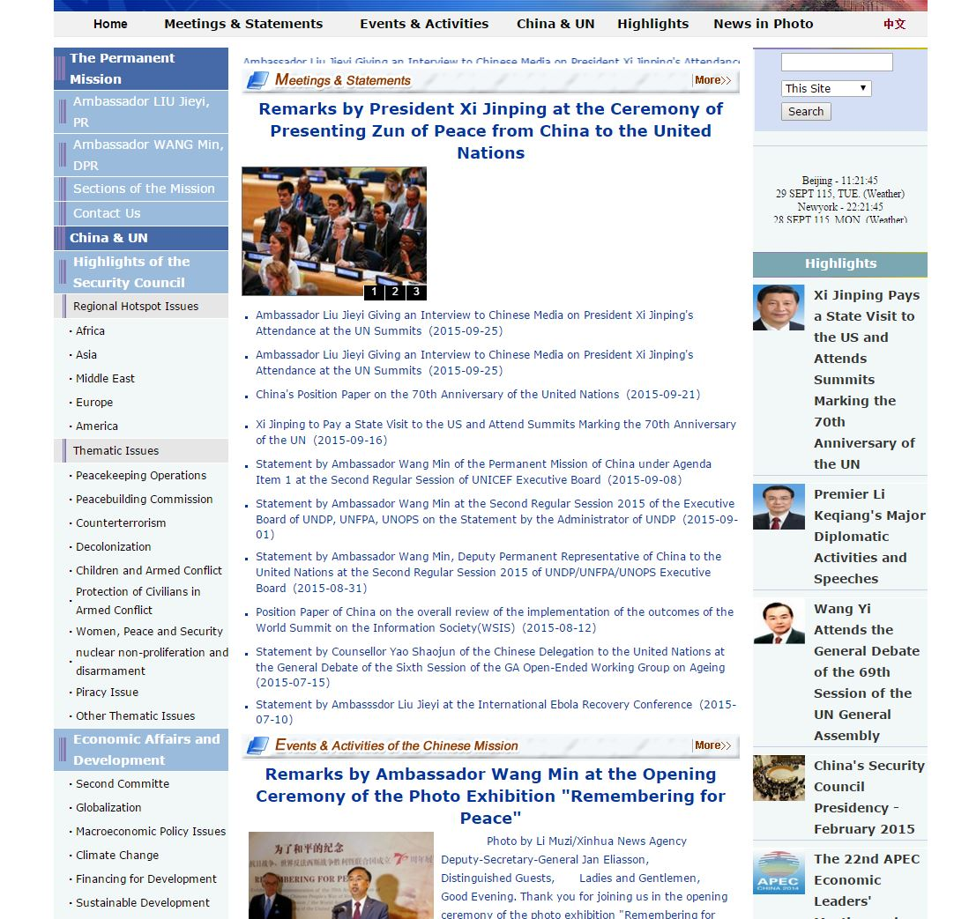
How to Discover your country’s Stance
Search website for your topic
China’s permanent mission to the UN
Google country name and committee topic
Search reputable newspapers (i.e. New York Times) about information about your country stance
If country is esp. important in regards to the committee topic articles may include info about company stance in article
Look at permanent missions of countries to the UN website, which provides most accurate information
Some topics have easily available info about them
Notes:
An example for a country that would be included in news articles is Iraq and Syria in regards to an ISIS topic.

Slide 6
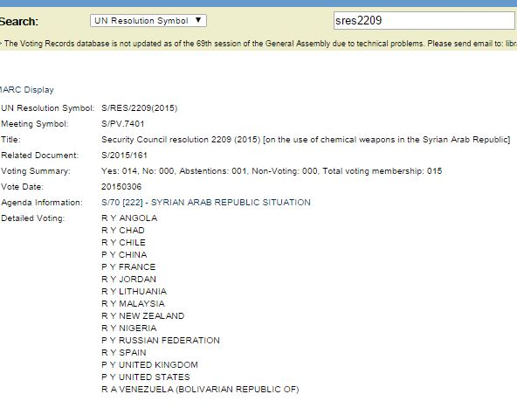
If you cannot find your country stance…
Look through country’s ministry of foreign affairs website
Look at country’s voting history for your topic on the UN Website
Ask if you any further questions
Voting tallies provide information about stance

Slide 7
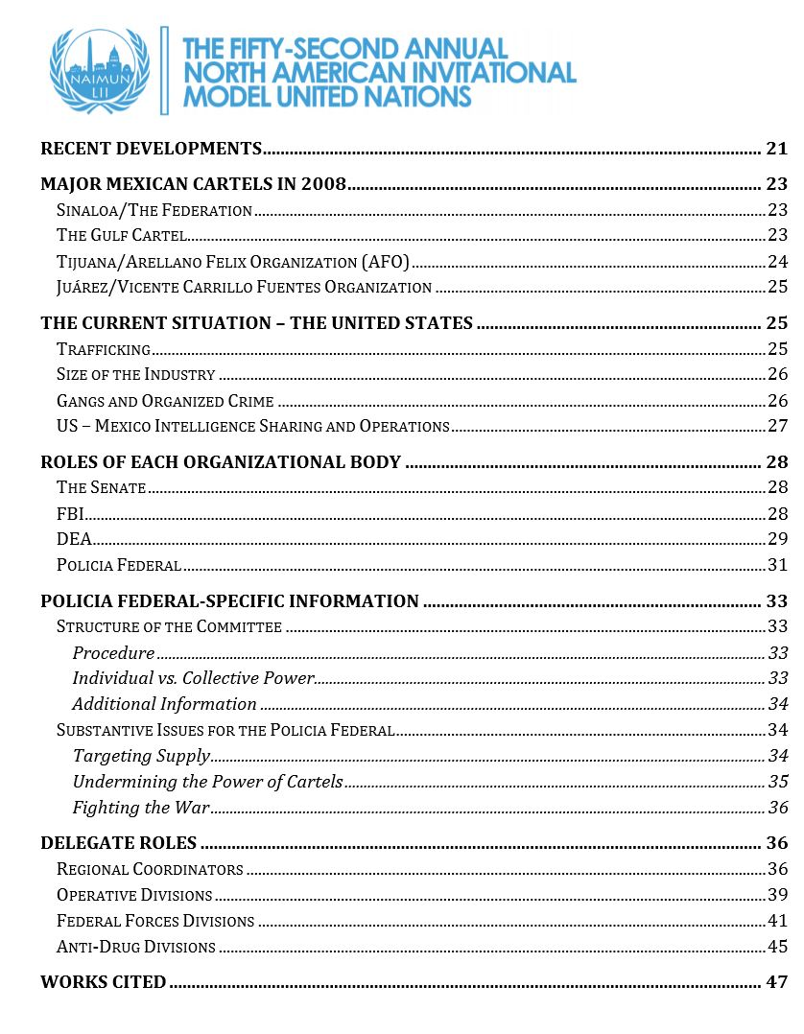
Starting Topic Research
Look into the background guides published on committee website
Include important background information about all topics and is starting point for research
Notes:
The background guides include comprehensive information about the topic and can be between a couple of pages to over 50 pages. They will have key information about the topic.
Check the website regularly, since the background guides take a while before they are published.

Slide 8
How to do Topic Research
Understand your topic
Key Actors and their opinions
Five W questions
Why is the topic important?
Preexisting solutions to issue
Look into preexisting UN resolutions and important treaties that may impact issues (e.g. UNCLOS)
Existing UN Treaties such as UNCLOS may be useful in understanding your topic

Slide 9
Proposing solutions
Look opinion pages of important newspapers; many have good ideas that can be implemented
Think thanks provide excellent solutions to MUN topics
Skimming Academic papers could be useful
After researching solutions proposed by others, think of at least 5 novel solutions to your topic

