Slide 1
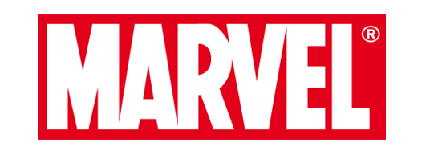

Slide 2
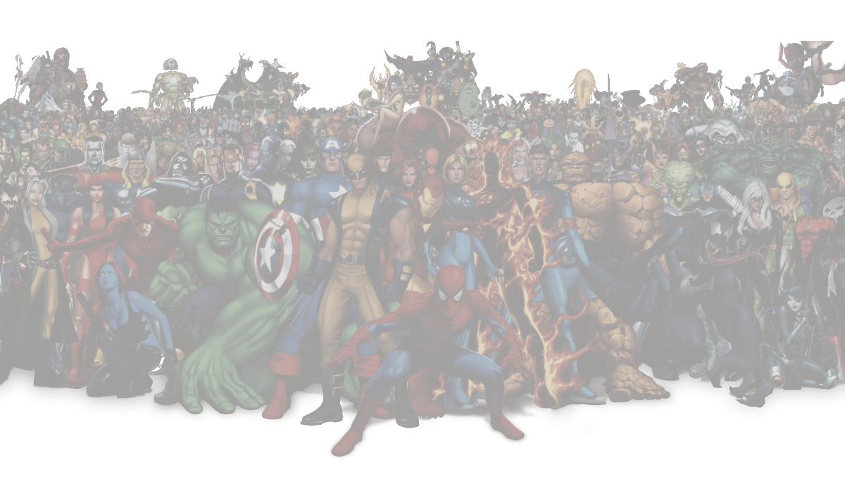
#1. Executive Summary
#2. Issues
Lack of female characters
Overload of comic series
#3. Recommendation
Use more undeveloped characters (e.g. more female)
Make TV Shows
#4. Case Study
DC’s Strengths and Weaknesses
#5.Appendix

Slide 3
Lack of adapting to current trends
Lack of Female characters
An overload of comic series
Create Female characters
Create Female characters
Make TV Shows
Make TV Shows
Performing traditional characters with new styles

Slide 4
Issue

Slide 5
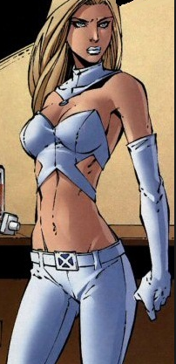
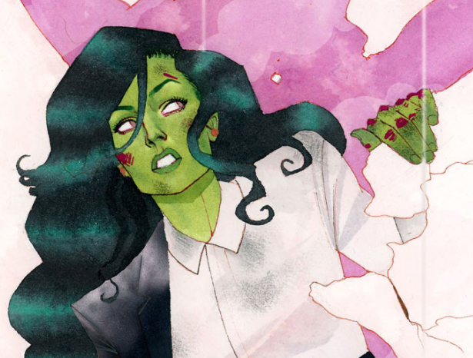
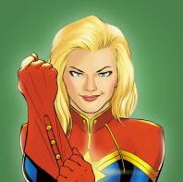
Lack of female characters in all Marvel Series
200 female characters, 500 male characters
Female characters also don't show up
Only Gamora in the New Guardians of the Galaxy film or Black Widow in The Avengers are successful

Slide 6
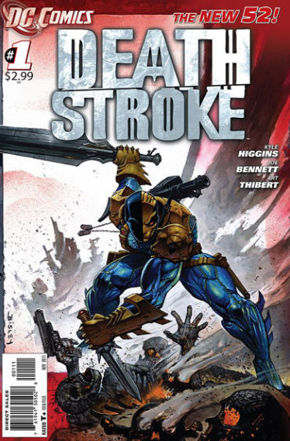
2. An overload of comic series
(Periodicals/graphic novels)
over 15,400 comic books and not read
Lack of popularity
Lazy to read all the series
Expensive ($10-$25)
Other approaches (movies, tv shows etc..)
“Not in style”
Competition
DC
The New 52

Slide 7
Recommendation

Slide 8
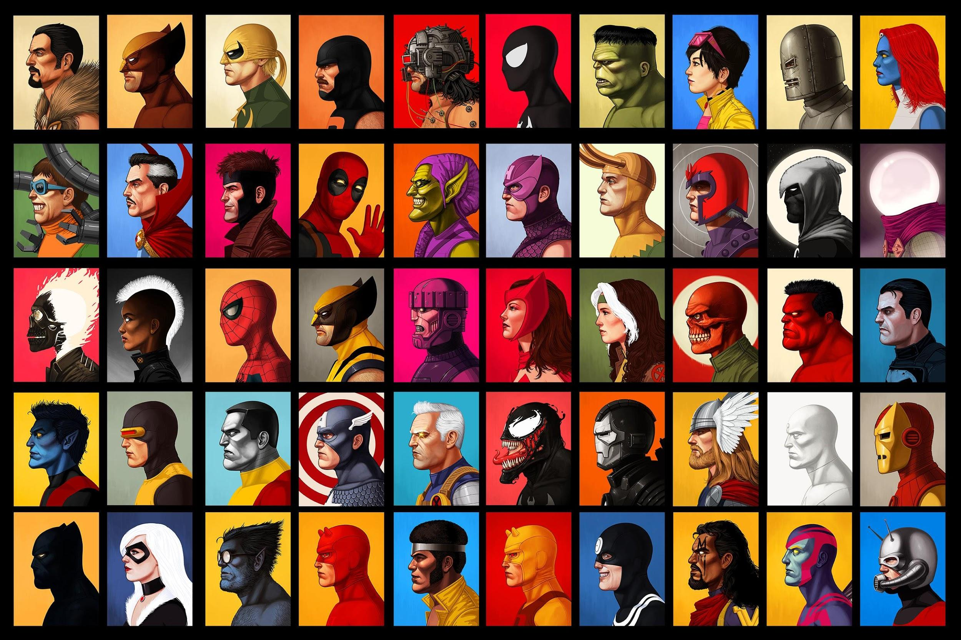
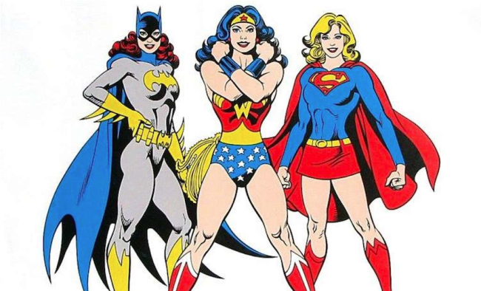
Making 30 minutes TV shows using famous and undeveloped characters
Use more female characters
- People can enjoy it with shorter amount of time.
- Variety of events
- More characters
- Being able to target more types of customers

Slide 9
Case Study

Slide 10
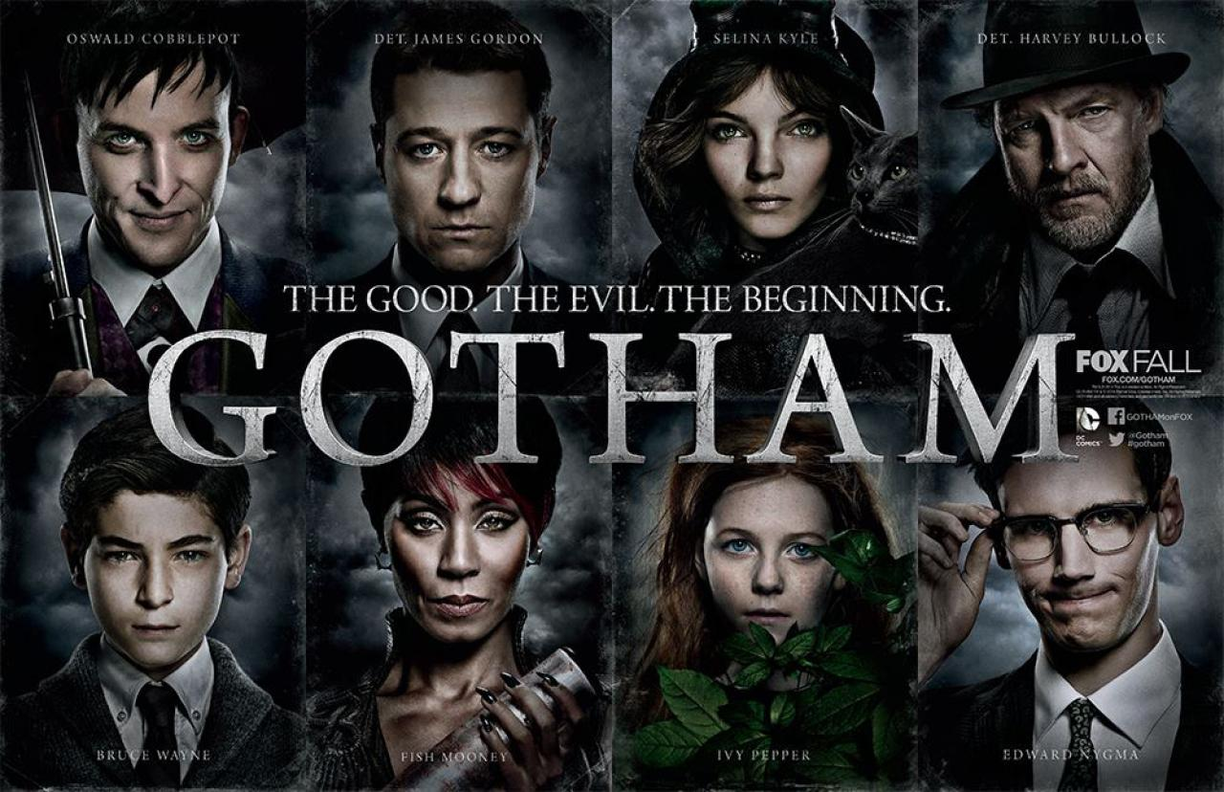
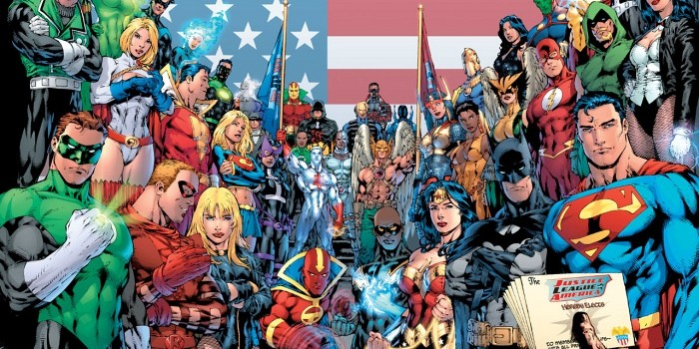
Learning from DC’s TV Show
Strength- Successful Rebooting
- (e.g. Gotham) -> used famous character (Batman) and made a TV show.
Weakness- Only using Famous Characters
- They are only using Characters that have been successful
- Therefore, stories became predictable

Slide 11
Appendix

Slide 12
Strengths:

