Slide 1
MARVEL

Slide 2
AGENDA_
Executive summary
Analysis
Alternatives
Recommendations
Implementation
Risks and Mitigation
Questions

Slide 3
EXECUTIVE SUMMARY

Slide 4
EXECUTIVE SUMMARY_
Objective
To have the greatest Marvel Experience
Issues
Lack of Female characters
Competition with DC
Solution
Make more extended female Character storylines
Creativity, and originality in new TV shows or Movies
Strengthen customer loyalty and relationship
Increase in a broader form of TV network
Outcomes

Slide 5
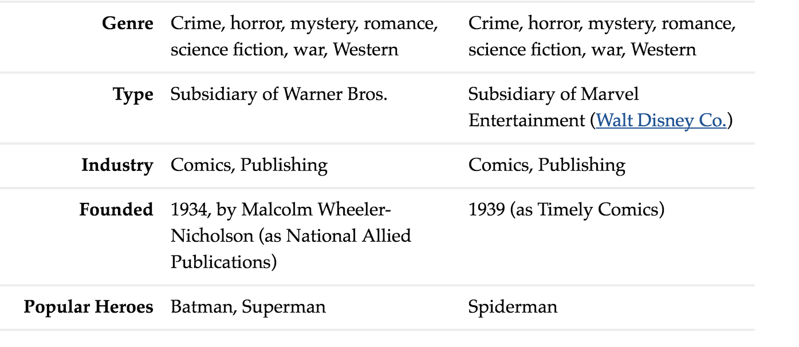
Analysis
Differences between DC Comics and Marvel Comics
Similarities between DC Comics and Marvel Comics
Following the trend

Slide 6
ALTERNATIVES_
ALTERNATIVE NUMBER 1:
ALTERNATIVE NUMBER 2:
Continue what they are already doing;
Keep reusing the common and popular characters, e.g. The Amazing Spider-Man
Take more control over more the creative process;
Take full control over the process of creating products that aren’t just comic books or toys (which they currently do)
E.g. Create their own movies.

Slide 7
RECOMMENDATION_
Taking Control
We recommend to:
Go with the alternative number 2: Take full control over the process of movie making and products that aren’t just comic books and toys.
There will be more profit if done right.
With Marvel’s platform currently dominating their competitions like DC, this is a good chance for Marvel to:
further increase their profits and success
Dominate the competition
There is a good chance of this happening, If using
the longtail method.

Slide 8
IMPLEMENTATION_
Take more control over more the creative process
1)RAISE AWARENESS OF NEW MOVIE RELEASES
Ex. Trailers
2) MAKE NEW MOVIE-AFFILIATED PLACES/PRODUCTS TO APPEAL TO FANS
Ex. MARVEL MUSEUM/ THOR HAMMER
3) MORE INTERVIEWS FOR CAST

Slide 9
_RISKS AND MITIGATION_
MAY NOT SUCCEED → WILL DO A PREVIEW OF PEOPLE’S INTERESTS (ex. survey)
PEOPLE MAY NOT LIKE NEW MOVIES/PRODUCTS → SAME AS # 1
COMPETITION FROM OTHER SIMILAR COMPANIES → WILL MAKE A DISTINCTION FROM COMPETITORS AND MITIGATE THEIR WEAKNESSES
Ex. DC/ SONY
NOT ENOUGH INVESTMENT → HOLD FUNDRAISING EVENTS OR GUARANTEE SPONSORSHIPS

Slide 10
Q & A

