Slide 1
MARVEL
By. Lina Cho, Jiyoon Hong, Marianne Kim, Daniel Seo

Slide 2
AGENDA
Executive Summary
Current Position in Market
Marvel & DC
4. Recommendation
5. Alternative
6. Conclusion

Slide 3
Executive Summary
Objective: To capitalize on Marvel’s profit
Issues: Traditional path / Shifting focus
Solution: Choosing 1. Their traditional path or 2. Shift their focus
Outcome: 1. Continue or exceed their profit margin 2. Gain a more diverse audience and find new markets

Slide 4
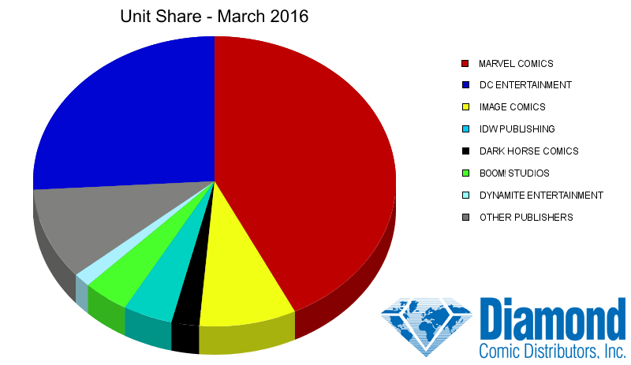
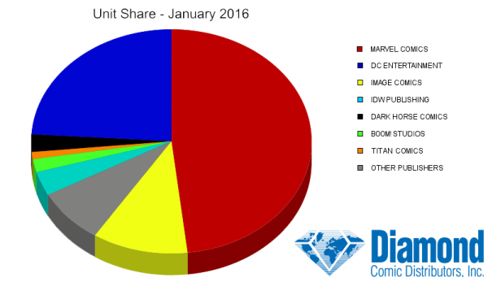
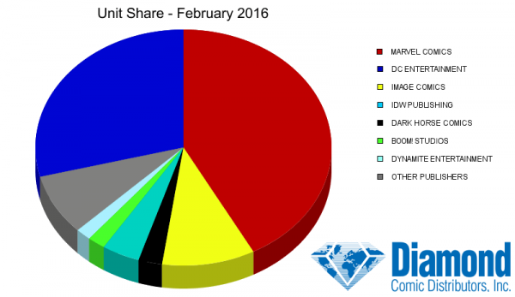
Current Position in Market
Dominates the entire comic book/superhero movie character bank
Licenses characters for movies, games, toys
Recently opened offices in Tokyo/London
licensed several of its most popular characters with studios for use in motion pictures

Slide 5
Marvel & DC
PoP | PoD
Similar product form Similar distribution form Similar target demo | Success in adapting comic book publishing structure to movies Greater diversity of characters X-men (historical success, sold to Fox) Different approaching to story telling

Slide 6
RECOMMENDATION

Slide 7
Recommendation
Look for niche markets (e.g. Deadpool for adults)
Utilize diversity in cast to draw in a new audience
Use lesser known stories and characters and rebrand them (e.g. The Punisher)
- Embrace Transient Edges -

Slide 8
Recommendation
Draw from old or unsuccessful comics
Rebrand characters
Expand into TV show market
Implementation

Slide 9
Recommendation
Marvel has acquired over 50% of the current market
They have to expand into the market they haven’t acquired or expand the market itself
By creating a more diverse cast, it creates interest from a different audience
Rebranding their characters introduces more interest from their original audience
Reason for Success

Slide 10
ALTERNATIVE

Slide 11
Alternative
Has an advantage over their competitors
Offers greater value
Continue focusing on their existing, high profile IPs
Release ensemble movies (e.g. Avengers)
Follow up movies with individually focused movies
Double Down on Competitive Advantage

Slide 12
CONCLUSION

Slide 13
Executive Summary
Objective: To capitalize on Marvel’s profit
Issues: Traditional path / Shifting focus
Solution: Choosing 1. Their traditional path or 2. Shift their focus
Outcome: 1. Continue or exceed their profit margin 2. Gain a more diverse audience and find new markets

