Slide 1
Marketing + Customer Retention
05.03.14 Week 7

Slide 2
Homework Check

Slide 3
4 P’s of Marketing
Product
Price
Promotion
Place

Slide 4
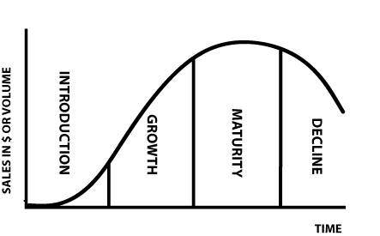
Product
Every product has a life cycle

Slide 5
Features of Product
Quality
Design
Features
Packaging
Customer Service

Slide 6
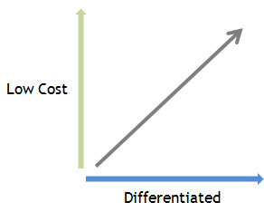
Price

Slide 7
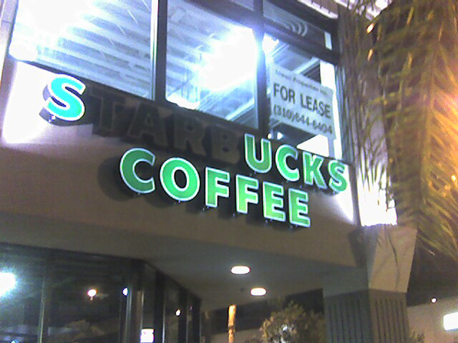
Starbucks?

Slide 8
Apple versus PC

Slide 9
Promotion
Communicating relevant product information
Advertising, public relations, social media marketing, and etc. (Customer Acquisition)
Ensure brand is communicated effectively on each platform.

Slide 10
BUDweiser

Slide 11
Force-Wagon

Slide 12
KIA Hamsters

Slide 13
Place
Place is the same as channels

Slide 14
Branding Tips
Logos
Slogans
Mascots
Integrate brand into ALL aspects of business (ie. Greetings, Starbucks cup sizes)
Create a unique “voice” for the company
Be consistent
Deliver value proposition
Try to make an emotional connection with customers

Slide 15
Customer Retention
Keeping current customers

Slide 16
General Customer Retnetion
CLEAR communication, no scams
Sell the way the customers want
Use words that customers are attracted to
Make the transaction process simple
Use bundle packages, reassuring words (ie. A small $5 fee)

Slide 17
Reciprocity
Getting your customers to keep coming back
Give back to your customers (doesn’t cost that much in the long-run)
Research shows an investment of 10 cents can create reciprocity
Have surprises, creates a greater effect
Personalize
Human nature to feel obligated to return favors, even if they are unasked for

Slide 18
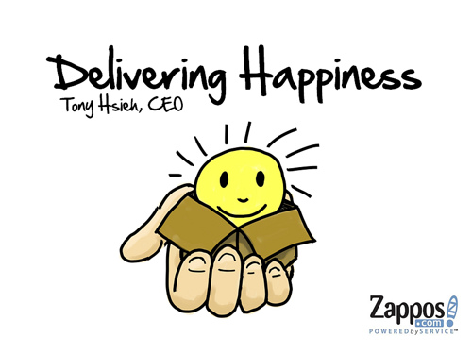
Reciprocity example

Slide 19
Customer Support/Service
Quality over speed
Don’t rush or ignore customers
Pick channel that customers prefer the most

Slide 20
Zappos does it again
Zappos sent flowers to a woman who ordered 6 different pairs of shoes because her feet were damaged
Customer service rep went to a rival shoe store to get a specific pair of shoes for a woman when Zappos ran out of stock
No scripts to read
No questions asked returns
Encourages people to order multiple sizes
No outsourced communication

Slide 21
Loyalty programs
If you start people with a loyalty card, they are twice as likely to finish it
Create a VIP class
Name your categories positively
Use a points system (simplicity is key!)
Partner with other companies
Make it fun! (Rrrrrrroll up the Rim!)

Slide 22
Homework: Keep adding to the document that you have. Customer Retention Strategy (2 different plans you will use) Identify your price vs. differentiation Brainstorm a commercial idea (promotion)

