Slide 1
Week 6:Cost Structure (Finance) Customer Relationships Revenue Streams

Slide 3
Peer Evaluations
At the end of the program, each of you will fill out a peer evaluation form.
You will be submitting comments and a percentage for each of your group members based on their contributions.
I will review all peer evaluations, and this will affect your future debate partner pairings. (ie. We’ll be more inclined to place hard-working students with hard-working students)

Slide 4
Cost Structure (Finance)

Slide 5
Fixed Costs vs Variable Costs
Fixed costs – costs that don’t change with the amount of production
Variable costs – costs that do change with the amount of production
*some costs can be a mix of both

Slide 6
Examples of Fixed vs. Variable
Rent
Electricity Bills
Plastic used for the product
Wages for workers
Contracts for workers
Marketing costs

Slide 7
Breakeven Point
Breakeven point – when all of your costs are covered.
Profit = Revenue – Costs
Generally, you want to make sure that your company is at least profitable by Year 3.

Slide 8
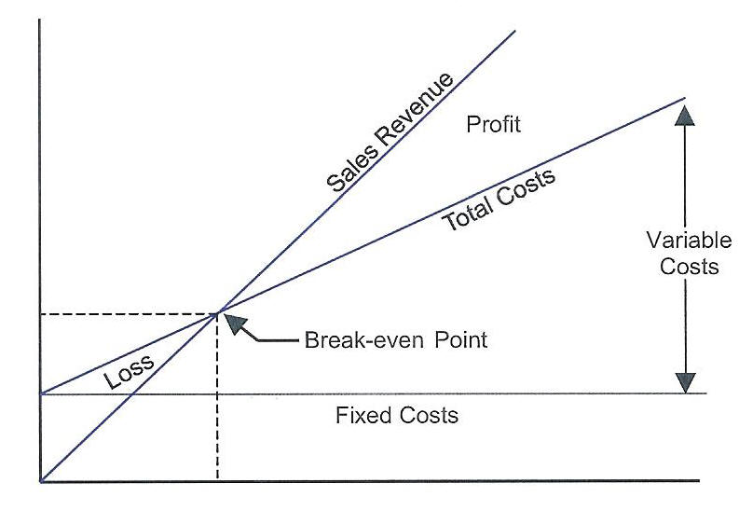

Slide 9
Revenue Stream

Slide 10
Revenue Streams
Revenue streams – different ways to bring in capital (money)
Asset Sale – retail (selling products)
Usage Fee – use of a service
Subscription fee – membership
Lending/Renting/Leasing – company owns, but given out to customers
Licensing – allow other companies to have access to your technology (patent) for a license fee

Slide 11
Customer Relationships

Slide 12
Customer Acquisition
Customer acquisition – gaining customers
Customer retention – maintaining current customers
We will cover customer retention in the next class

Slide 13
Content Marketing

Slide 14
Search Engine Optimization

Slide 15
E-mail Marketing

Slide 16
Conversion Rate Optimization
Number of customers you get as a visitor, who you can convert to a paying customer

Slide 17
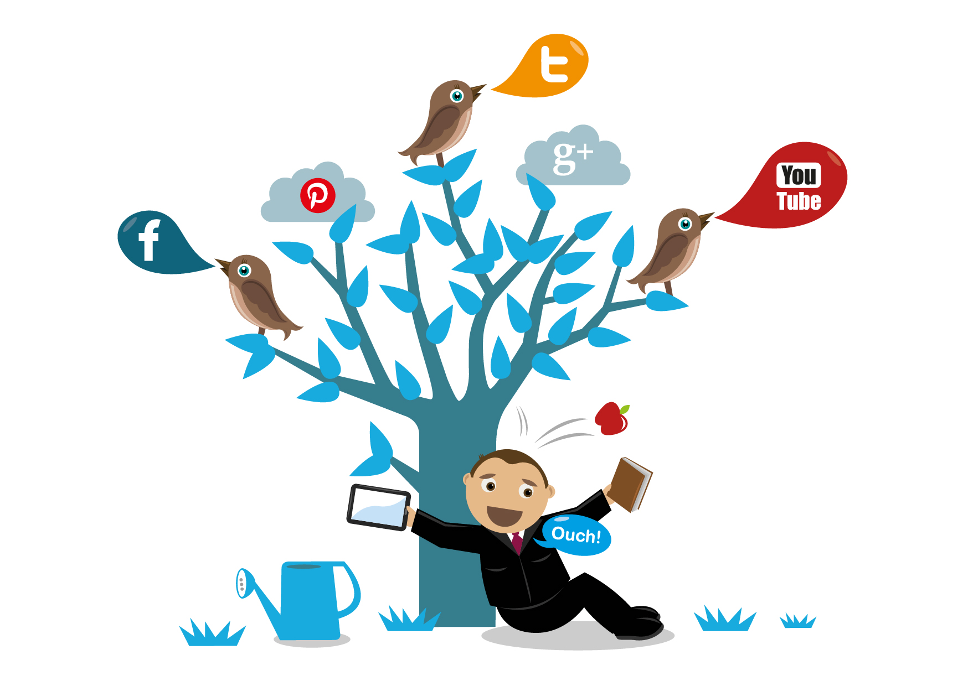
Social Media Marketing

Slide 18
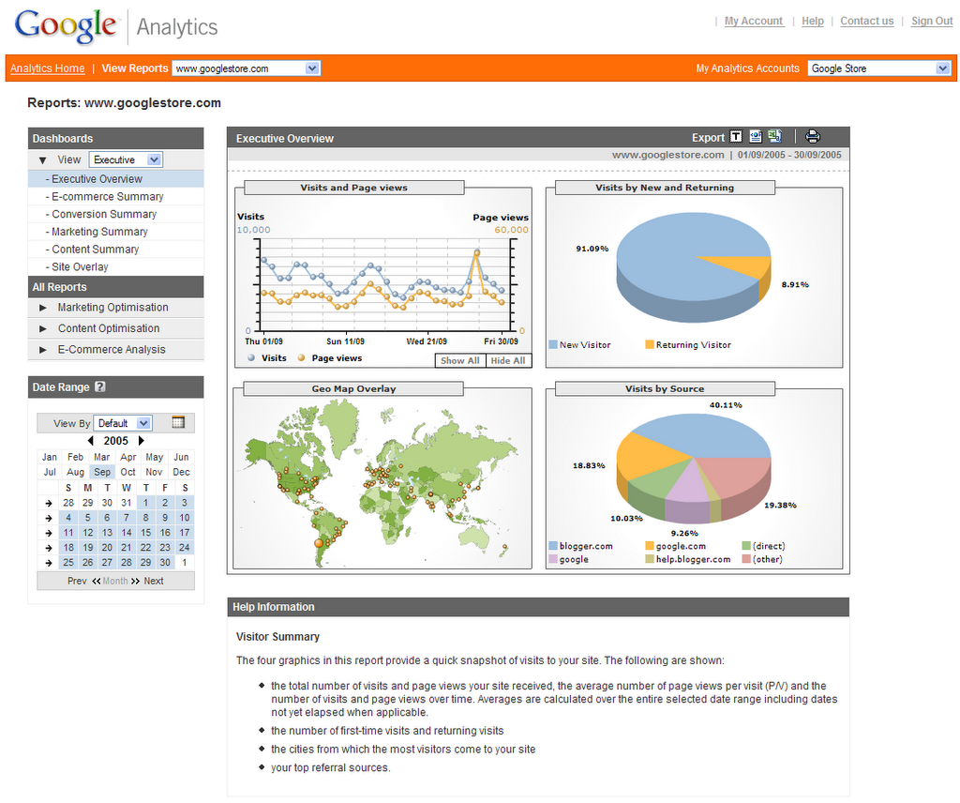
Analytics

Slide 19
Homework
Cost Structure – Figure out all of the costs for your company (separate into fixed & variable costs) – I will help you later with the breakeven analysis
Revenue Stream – Define the revenue stream(s) that you will use to make money (paragraphs explaining what you will be using and why)
Customer Acquisition Strategy – 2 different methods that you will GET customers (have paragraphs explaining what you will be doing and why)

Slide 20
Start getting organized
For next class, you MUST bring 1 word document that has your company name, logo, and slogan. - A brief description of what your product is (abstract) - Value Proposition written out - Customer Segment defined - Channels and process on how (paragraph) - Cost Structure homework - Customer acquisition plan - Revenue Streams defined

