Slide 1
Week 5: Company Names, Logos, Slogans

Slide 2
KEEP CALM AND ENTREPRENEURSHIP ON

Slide 3
Company Names
Have meaningful purpose behind the name.
Make sure it sounds good – no tongue twisters; alliteration is good.
No weird abbreviations that nobody can spell.
Make people intrigued, or want to go to your company; also make it memorable.
Keep it classy, don’t make it too funky or creative.

Slide 4
Greek Goddess of Victory, Swoosh symbolizes flight
Sky Peer-to-Peer
Name from Adobe Creek behind Co-Founder’s House
Minnesota Mining and Manufacturing Company

Slide 5
Colors in Logos
Different colors unconsciously stimulate a reaction in people.
Choose your colors wisely…

Slide 6
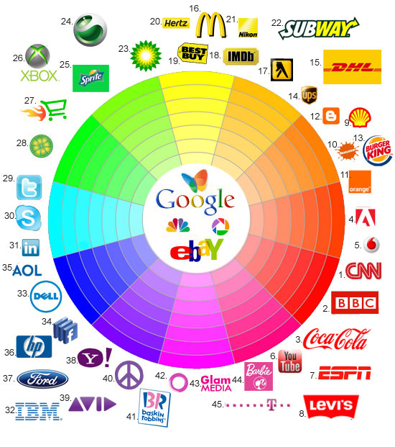
Color | Effect
Green | Environmental, Eco-friendly, Wealth (finance), Health
Blue | Freshness, Academic, Professional, Reliable (banks), Secure, Authority
Red | Insightful, Hunger, Grab’s the Attention of People, Passion
Yellow | Knowledge, Helpfulness, Fun, Warmth, Happiness, Safe
Orange | Pleasure, Enthusiasm
Purple | Ambition, Dignity, Mystery, Independence, Luxury
Brown | Comfort, Strength, Laziness, Isolation
Black | Power, Mysterious, Grieving, Elegance
White | Innocence, Purity, Cleanliness

Slide 7
Slogans
Work with a logo
Need audience to be able to understand it right away, keep it simple
Humor is good, but depends on the product
Be honest, don’t include anything crazy
Make sure it flows, and actually fits what your company is about

Slide 8
Sample Slogans
“Live in your world. Play in ours.”
“There is no substitute.”
“The happiest place in the world.”
“I’m lovin’ it.”
“Good to the last drop.”
“It’s everywhere you want to be.”

Slide 9
Any Questions?

Slide 10
Homework: Finish company name, logo, and slogan! (and anything else that isn’t finished)

