Slide 1
Week 4: SWOT + Idea Finalization

Slide 2
Administrative
Should’ve all emailed Eric (ericcho24@gmail.com) with business idea (brief description) + Value Proposition + Customer Segment
If you still haven’t done so, you have until April 12th, 11:59 p.m.
If not in, every member of the team will get a zero in entrepreneurship.

Slide 3
SWOT Analysis
The SWOT is a useful tool in business used to analyze a company
SWOT = Strengths, Weaknesses, Opportunities, Threats
Strengths + Weaknesses refer to internal features of a company
Actions that a company can/could directly influence
Opportunities + Threats refer to external features of a company
Uncontrollable aspects related to the company that affect the company in someway

Slide 4
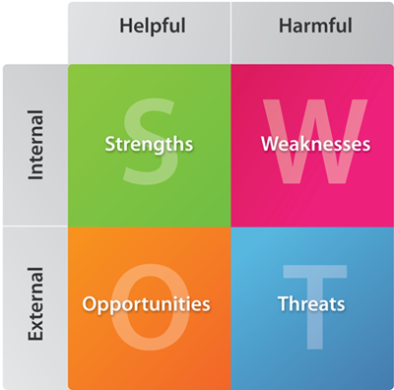

Slide 5
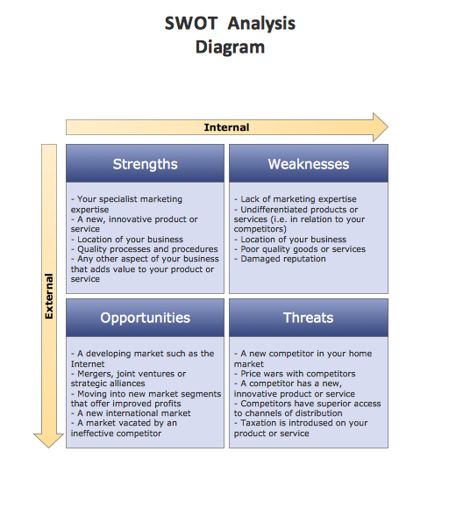

Slide 6
Idea Finalization

Slide 7
General guidelines
Idea is realistic and possible; no super crazy pill that will make you invisible or something
You don’t actually have to create the product/service
Apply as much of the things we learned so far in class (ie. Value proposition, Customer Segments, Shared Value, and etc.)
Look back at previous class slides on the website if you forgot
Research what other companies are doing; don’t copy, but get inspired

Slide 8
Finalize with robert

Slide 9
Homework
Write a SWOT for your company; the SWOT has to be a 2x2 square matrix, as shown in this presentation – minimum 5 points in each category
Bring for next class
Email ericcho24@gmail.com if you have any questions or concerns about the project

