Slide 1
Week 3: Competition Overview + Effective teams
03.15.14

Slide 2
Competition information
End of may
In front of real business professionals
7 Minute Presentations + 1 Minute Q&A
CASH PRIZE!

Slide 3
First place: $200 Second place: $100

Slide 4
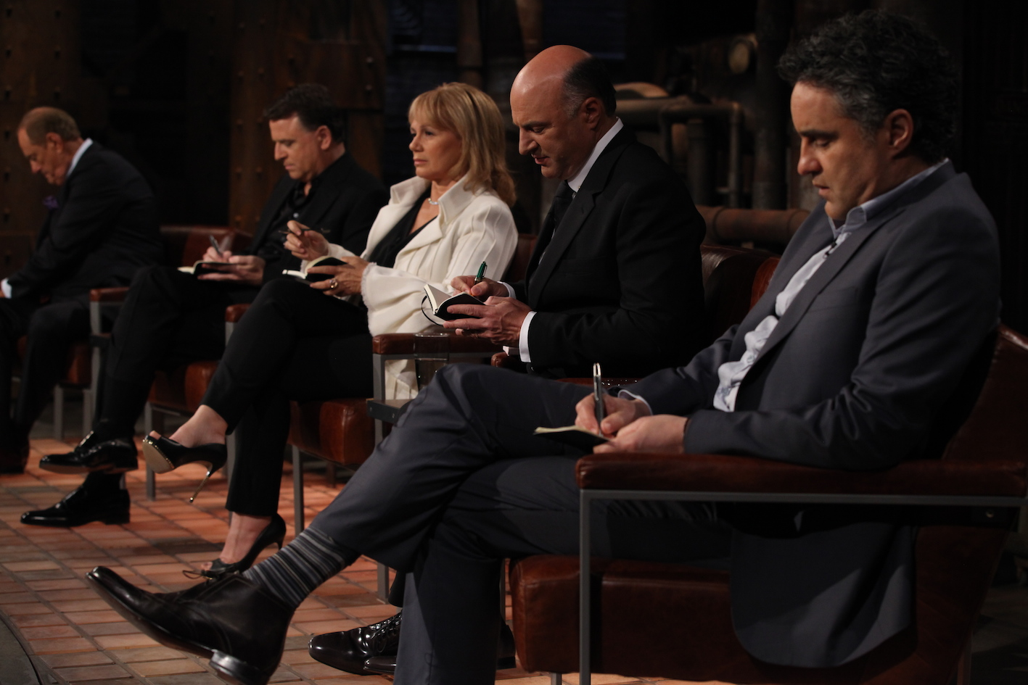
Your class is your business team

Slide 5
Any questions?
Regarding the competition

Slide 6
Effective Teamwork

Slide 7
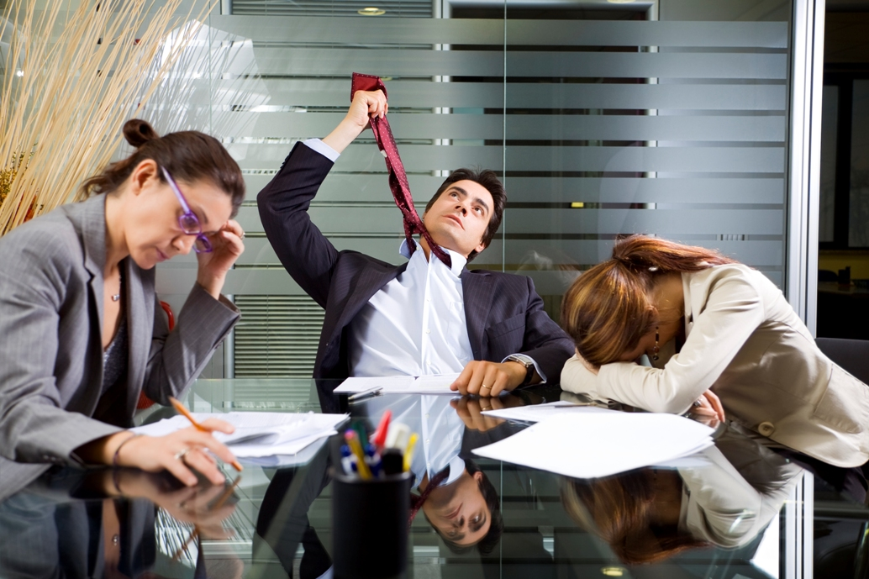

Slide 9
Great teams….
Have mutual respect
Great team chemistry
Don’t vote on decisions
Meet in a prepared manner
Unified clear goals
Participation + Listening
Ground rules

Slide 10
At the individual level…
First impressions
Be prepared and on time
Be a giver, not a taker
Share knowledge and help others
Be a PART of the company
Don’t see others as competitors

Slide 11
Companies are also responsible for creating a great organizational culture

Slide 13
Brainstorming
Never erase ideas
Don’t put down others
Record EVERYTHING – have one person doing this
Have a decision criteria
Plan for the next meeting

Slide 15
Homework: 1.Create a method of communication with your team 2. Pick one business idea. 3. Create value proposition. 4. Determine customer segment.

