Slide 1
Customer Segments Value Propositions Channels
03.08.14 – week 2

Slide 2
“SHARE” some Shared Values

Slide 3
Customer Segments

Slide 4
Customer Segments
Different groups of people and organizations an enterprise aims to reach and serve
Into sections with common needs, common behaviours, or other attributes
Focus on some, not all

Slide 5
Which customer segments?

Slide 6
Types of Customer Segments
Mass Market – doesn’t segment
Niche Market – Specific customer segments
Ie. A car part manufacturing company targets automobile manufacturers
Segmented – segmented between slightly different needs and problems
Ie. A bank meets needs of people with different income levels differently
Diversified – meeting needs of two different customer segments

Slide 7
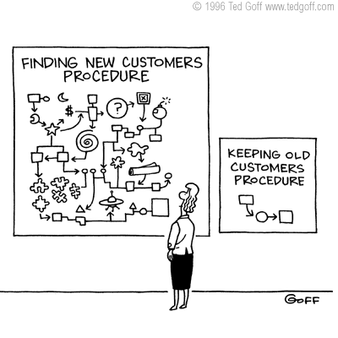

Slide 8
Value Propositions

Slide 9
Value Propositions
The reason why customers prefer one company over another; the benefits/values that a company offers to its customers
Usually integrated into slogans
“Just Do It” – if you buy Nike apparel, it will make you exercise
Persuade customer why they should buy from you

Slide 10
Different Forms of Value
Newness
Brand
Convenience
Performance
Price
Customization
Risk Reduction
Design
“Getting the job done”

Slide 15
Value you bring to customers

Slide 16
Channels

Slide 17
Channels
How a company communicates with and reaches its customer segments to deliver a value proposition
Sales Force
Web Sales
Own Stores
Partner Stores
Wholesaler

Slide 19
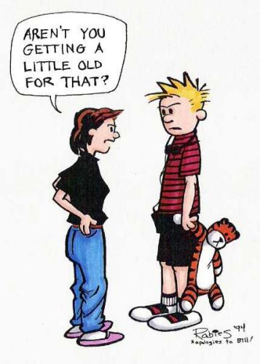

Slide 20
Any Questions?

Slide 21
Homework: Brainstorm a need in society, think of products/services to meet that need. Have at least 3 different ideas. Think of that idea’s customer segment and value proposition!

